Slide 1
Rovi 1.0 – The HealthBot
The ChatBot which helps you in maintaining your Medical Report in your Smartphone

Slide 2
The Rovi Crew
By, Guided by,
S Jayendran - 15IT14 Ms. Sathya N – AP/IT
S Prasanth - 15IT28
S Sharmi - 15IT40

Slide 3
ROVI - ABSTRACT
An application that takes care of one’s Health
Help people to monitor their health conditions
People can identify their disease based on the symptoms
Main scope & objective
To suggest the medicine for the diseases.
Efficient way of report maintenance.
Rovi 1.0 is born from the three Budding Software engineers. At present, we have such things but this rovi will stand out in many aspects.

Slide 4
EXISTING SYSTEM
These Systems does not have a report generating capability such that
the people may feel unsatisfied with the volatile access to their previous inputs.
They have no ability to compare the current input with that of the past
histories.

Slide 5
PROPOSED SYSTEM
Assist the common people in their Health Maintainence
Maintaining a Medical Report for individual.
The Day-to-Day feed about one’s body condition to rovi
helps you to generate a report of your health.
Identification of serious deadly disease based on the inputs
provided to it.
Rovi reads the provided inputs and store them for future
purpose.

Slide 6
Core Technologies:
AWS
Facebook Bot
Machine Learning

Slide 7
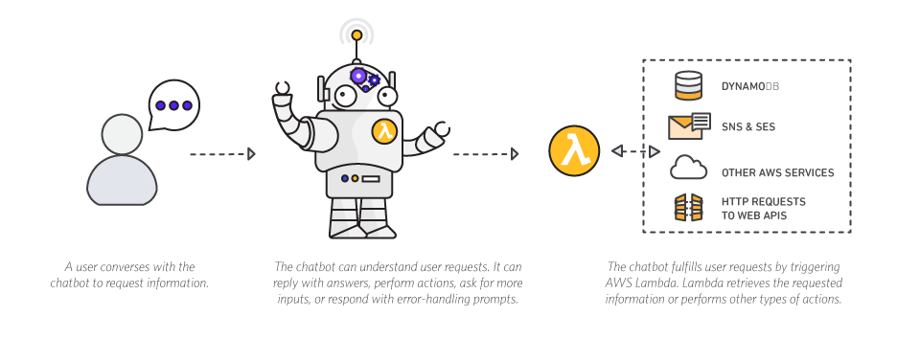
AWS

Slide 8
Lex
Amazon Lex, the same deep learning technologies that power Amazon Alexa are now available to any developer, enabling you to quickly and easily build sophisticated, natural language, conversational bots (“chatbots”).
Speech recognition and natural language understanding are some of the most challenging problems to solve in computer science, requiring sophisticated deep learning algorithms to be trained on massive amounts of data and infrastructure

Slide 9
Benefits of Amazon Lex:
Easy to use
Seamlessly deploy and scale
Built in integration with AWS
Cost effective

Slide 10

Facebook chatbot
"Bot" is a generalized term used to describe any software that automates a task. Chatbots, which anyone can now build into Facebook Messenger, automate conversation

Slide 11
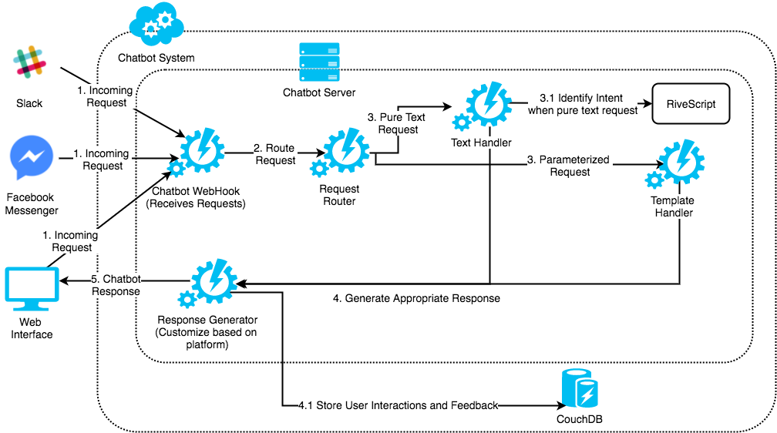
Amazon lex and Facebook integration:

Slide 12
Procedure to integrate Amazon LexBot and Facebook :
Create an Amazon Lex bot
Create a Facebook application
Integrate Facebook Messenger with your Amazon Lex bot
Validate the integration

Slide 13

Lambda function:

Slide 14
What is Lambda in AWS?
AWS Lambda is a serverless compute service that runs your code in response to events and automatically manages the underlying compute resources for you.
You can use AWS Lambda to extend other AWS services with custom logic, or create your own back-end services that operate at AWS scale, performance, and security.

Slide 15
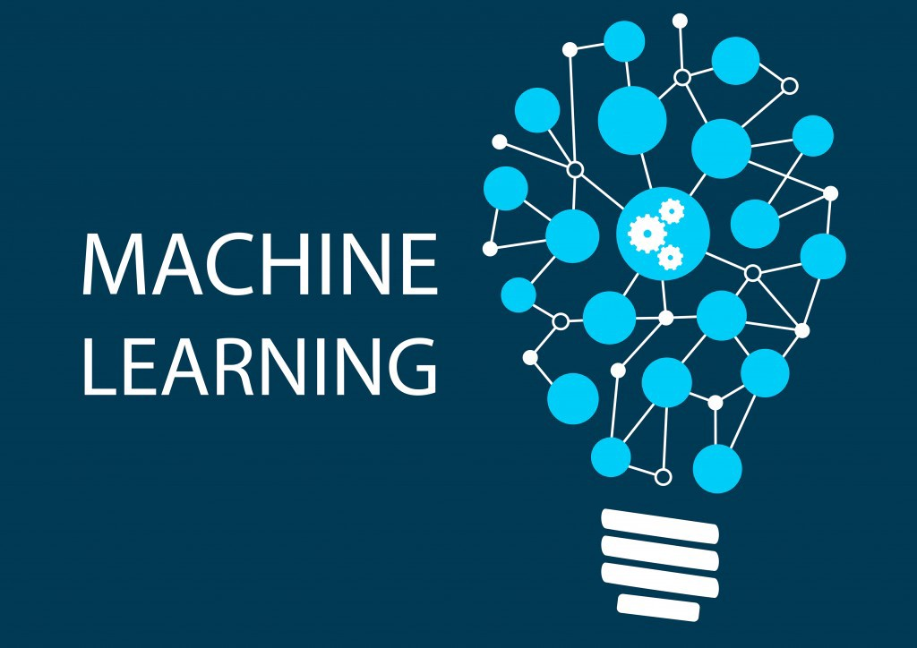
Machine Learning :

Slide 16
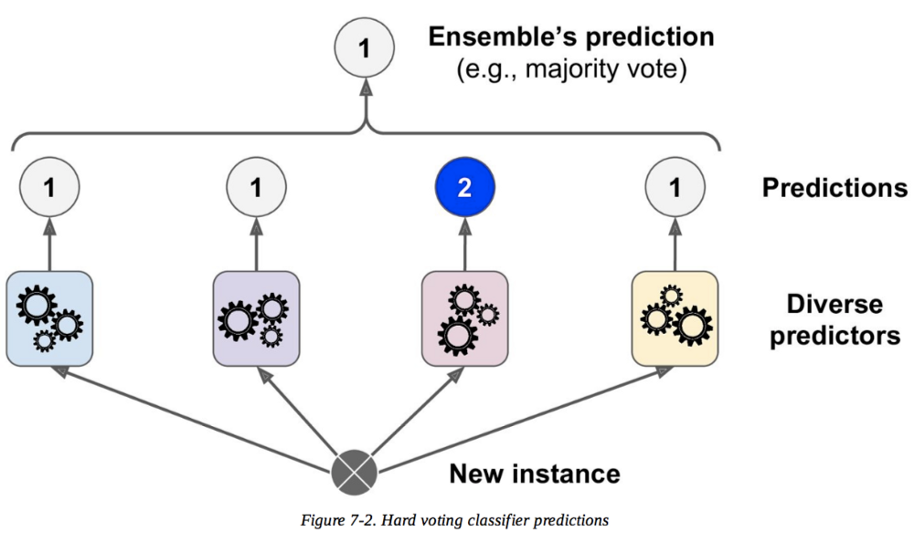
ML algorithms used in ROVI BOT:
Random forest
Decision tree(ID3)

Slide 17
Why Random Forest?
A random forest is simply a collection of decision trees whose results are aggregated into one final result.
One way Random Forests reduce variance is by training on different samples of the data.
Their ability to limit overfitting without substantially increasing error due to bias is why they are such powerful models.

Slide 18


Slide 19
Voting:
Hard voting is where a model is selected from an ensemble to make the final prediction by a simple majority vote for accuracy.
Soft Voting can only be done when all your classifiers can calculate probabilities for the outcomes. Soft voting arrives at the best result by averaging out the probabilities calculated by individual algorithms.

Slide 20
Bagging and Pasting
Instead of running various models on a single dataset, you can use a single model over various random subsets of the dataset.
Random sampling with replacement is called Bagging, short for bootstrap aggregating.
In case that was difficult to visualize in your head, just imagine disregarding several random entries in the dataset and modelling with the rest. In case of Pasting, the same process applies, only difference being that pasting doesn’t allow training instances to be sampled several times for the same predictors.

Slide 21
Writing Lambda function in AWS:
Authoring Code for Your Lambda Function
Deploying Code and Creating a Lambda Function
Creating a Deployment Package – Organizing Code and Dependencies
Uploading a Deployment Package – Creating a Lambda Function
Testing a Lambda Function

Slide 22
Deploying an Amazon Lex Bot on Facebook:
Attribute | Description
channel-id | The channel endpoint identifier from Amazon Lex.
channel-name | The channel name from Amazon Lex.
channel-type | Facebook
webhook-endpoint-url | The Amazon Lex endpoint for the channel.
Attribute | Description
user-id | The Facebook identifier of the sender. See https://developers.facebook.com/docs/messenger-platform/webhook-reference/message-received.
facebook-page-id | The Facebook page identifier of the recipient. See https://developers.facebook.com/docs/messenger-platform/webhook-reference/message-received.
Facebook Request Attributes

Slide 23
REFERENCES:
Sheetal L. Patil, “Survey Of Data Mining Techniques In Healthcare”, International Research Journal of Innovative Engineering, Volume: 01 Issue: 09, September-2015.
“Classification of large datasets using Random Forest Algorithm in various applications: Survey” ,Mohammed Zakariah Researcher, King Saud University College of Computer and Information Sciences, Riyadh, Kingdom of Saudi Arabia
International Journal of Engineering and Innovative Technology (IJEIT) Volume 3, Issue 11, May 2014 “Effective Learning and Classification using Random Forest Algorithm”, 1Vrushali Y Kulkarni, 2 Pradeep K Sinha.
“Ensemble Methods for Classification Of Patients For Personalized Medicine With High-Dimensional Data”. Artificial Intelligence in Medicine 41:197–207,2007.

Slide 24


Slide 25
THANK YOU…!

